Slide 1
How to build a statistical graphic
Notes:
Visualization – any way to create diagram/images/visual artifacts to communicate a message.
Statistical graphic is a type of visualization that is concerned with statistical properties of your data
Infovis when spatial representation is _chosen_ (vs given in sci-vis)
I think it’s helpful to model any data that we’ve looked at as a visualization. And before we talk about statistical graphics and visualizations,

Slide 2
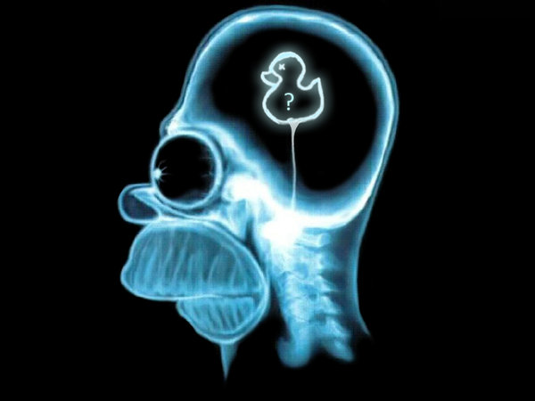

?
>
Notes:
Our supremecy over the animal kingdom
One way to measure it could be the mass of the brain. But maybe it should depend on body mass.
So let me present to you a visualization of brain and body mass data for a number of animals

Slide 3
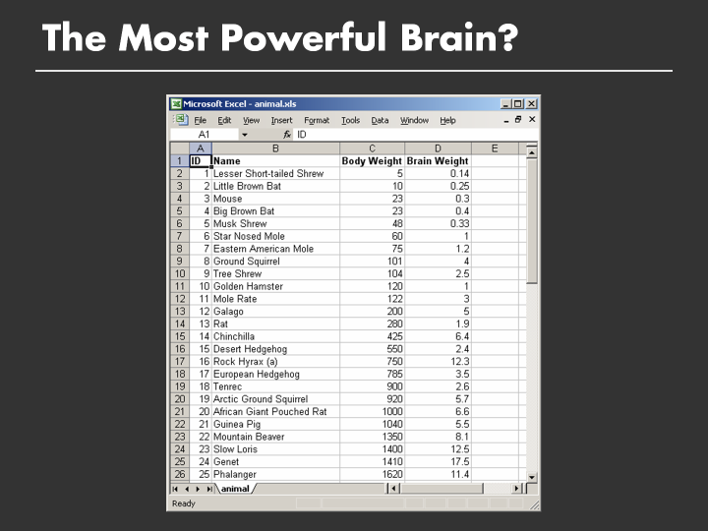
Notes:
This is a visualization of body weight to brain weight in a tabular format
However it may be difficult to reach any conclusions about what our most powerful brain is, partly because we have two numeric variables and are trying to
Compare them. In order to make any comparisons, we need to mentally pair up and sort the values individually, which is hard

Slide 4
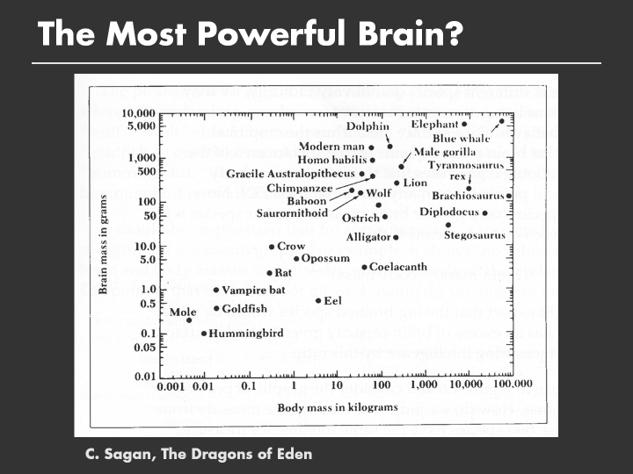
Notes:
What does this plot do better than the previous?
Blue whale
Stegosaurus
We have more brain than chimps, baboons and gorillas

Slide 5
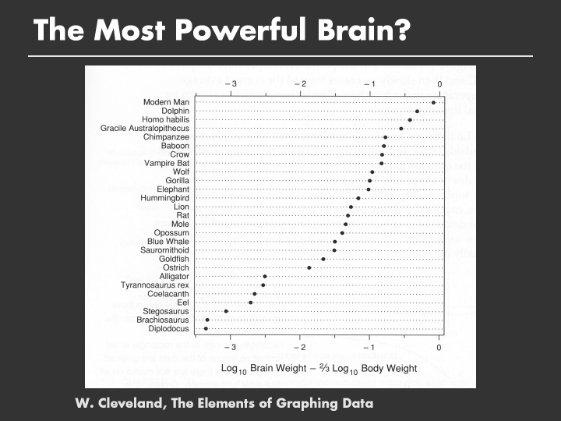
Notes:
If you fit the previous line, there’s roughly a Brain = c * (body^2/3) relationship
Another way to phrase this is that you can lie with statistics
The reason why this visualization is so effective is
It is clear what the goal of the plot is
It is clear along what metric we are making these comparisons
The visualization helps us perform these comparisons directly
The y axis is sorted by the ratio, so it is easy to scan and make broad comparisons
The use of ink helps and doesn’t hinder us

Slide 6
Representation of data that
eases the path to insight
Notes:
Double chocolate 1.75 10
Oatmeal raisin 10
Almond biscotti 1.75 10
Sticky buns 3.50 15
Muffin cakes 3 10

Slide 7
"Clear and precise seeing becomes as one with clear and precise thinking"
-Tufte
http://www.onlineethics.org/Topics/ProfPractice/Exemplars/BehavingWell/RB-intro/RepMisrep.aspx
Notes:
Another way to say this, is a phrase by edward tufte.
Poor representation mirrors poor reasoning and encourages and sustains it. Once we go astray in our reasoning, our visual representation not only confirms the bad reasoning which it embodies, but compounds our problems by leading us into further errors.

Slide 8
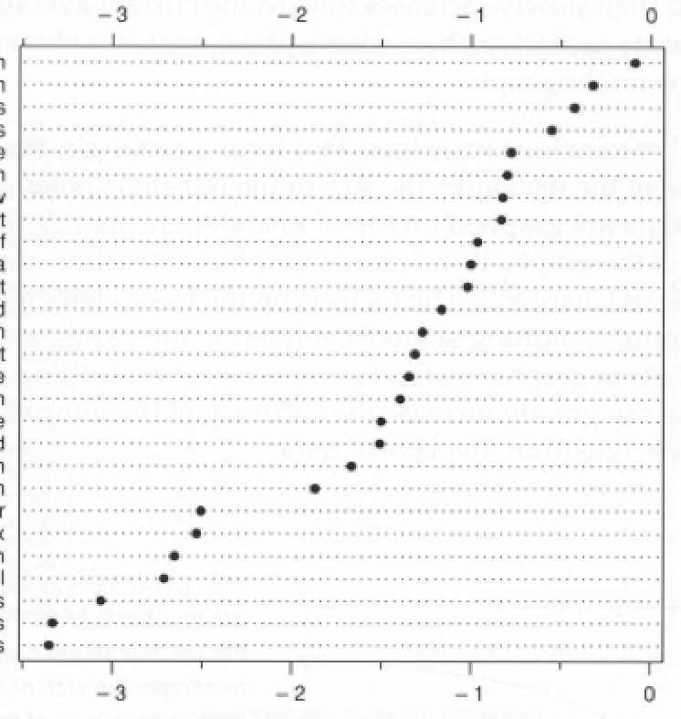
Outline
Visual Statistics
Graphical Principles
Visualization Toolkits
Tidy
Data
Notes:
Try to have a grip of examples

Slide 9
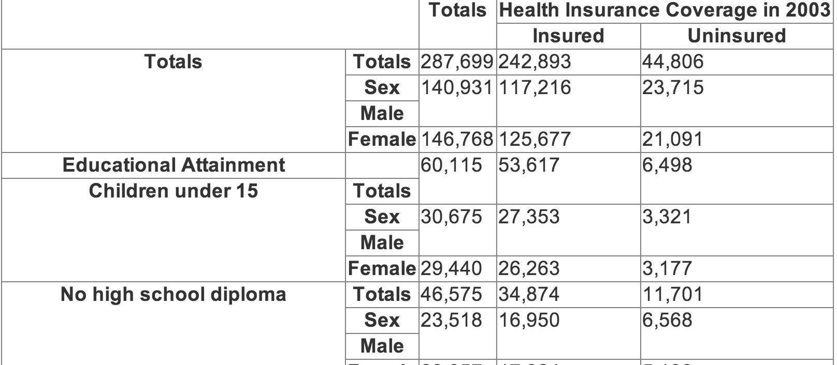
Notes:
To give you a sense of what “tidy” means.
This is a census report of insured people by education.
This is a report, not tidy data
The totals are computed aggregates, and are mixed together with individual observations
Totals column
Totals row
Even ignoring the alignment, there are issues

Slide 10
Each variable forms a column
Each observation forms a row
Each table stores info about one observational type
Hadley Wickham

Slide 11
Education | Gender | Insurance | Count
Under 15 | Male | yes | 27353
Under 15 | Male | no | 3321
Under 15 | Female | yes | 26263
Under 15 | Female | no | 3321
No HS | Male | yes | 16950
No HS | Male | no | 6568

Slide 12
How to tell a story with data?
Quantify with statistics
Explain with visualizations
Statistical
Graphics

Slide 13
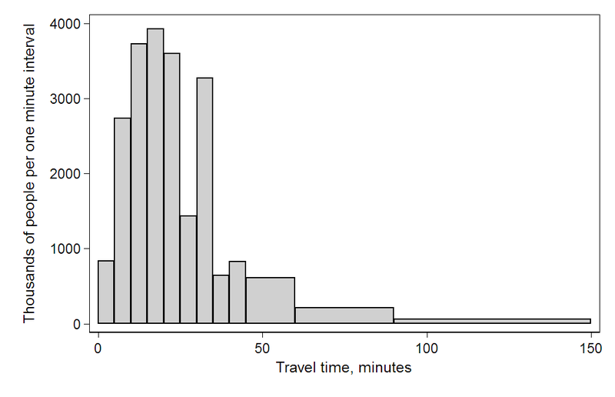
Statistics is about distributions
Notes:
https://en.wikipedia.org/wiki/File:Travel_time_histogram_total_n_Stata.png

Slide 14
summarizing distribution w/ numbers summarizing distribution w/ trends comparing distributions correlating distributions

Slide 15
Summarize me
Notes:
https://en.wikipedia.org/wiki/File:Travel_time_histogram_total_n_Stata.png
Average? Median? 90th percentile? Skew? Std dev?

Slide 16
Quantifying uncertainty
US avg.
(6.885)
US avg.
(census)
0
minutes spent commuting
Notes:
How to quantify this

Slide 17
summarizing distribution w/ numbers summarizing distribution w/ trends comparing distributions correlating distributions

Slide 18
Distributional trends

Slide 19
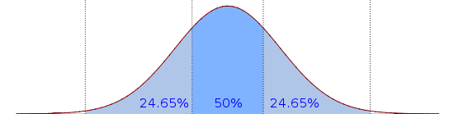
Distributional trends

Slide 20
Median
Notes:
https://en.wikipedia.org/wiki/File:Boxplot_vs_PDF.svg

Slide 21
25%
75%
Notes:
https://en.wikipedia.org/wiki/File:Boxplot_vs_PDF.svg

Slide 22
Inner Quartile Range
Notes:
https://en.wikipedia.org/wiki/File:Boxplot_vs_PDF.svg

Slide 23
Whiskers / Extremes
Notes:
https://en.wikipedia.org/wiki/File:Boxplot_vs_PDF.svg

Slide 24
Outliers
Notes:
https://en.wikipedia.org/wiki/File:Boxplot_vs_PDF.svg
----- Meeting Notes (1/9/12 16:23) -----
make arrows shorter

Slide 25
Box-and-Whiskers Plot

Slide 26
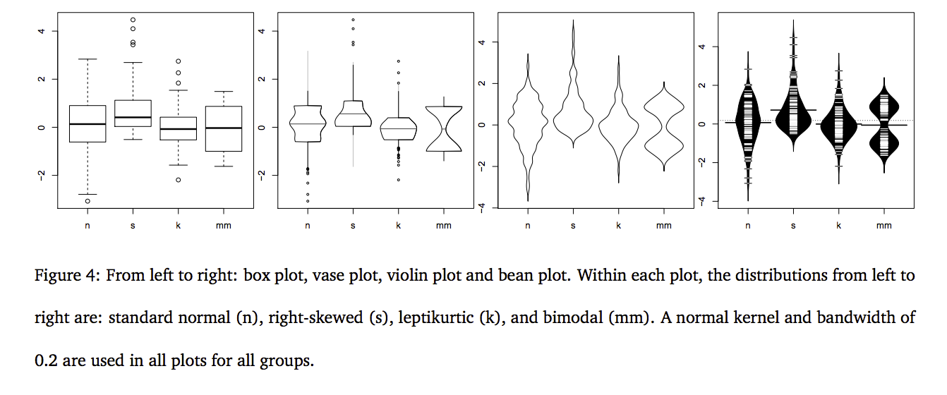
from http://vita.had.co.nz/papers/boxplots.pdf
Notes:
http://vita.had.co.nz/papers/boxplots.pdf
But sometimes you just want to show the whole distribution

Slide 27
summarizing distribution w/ numbers summarizing distribution w/ trends comparing distributions correlating distributions

Slide 28
Commute time MIT vs. USA
minutes spent commuting
USA
MIT
USA
MIT
0

Slide 29
summarizing distribution w/ numbers summarizing distribution w/ trends comparing distributions correlating distributions

Slide 30
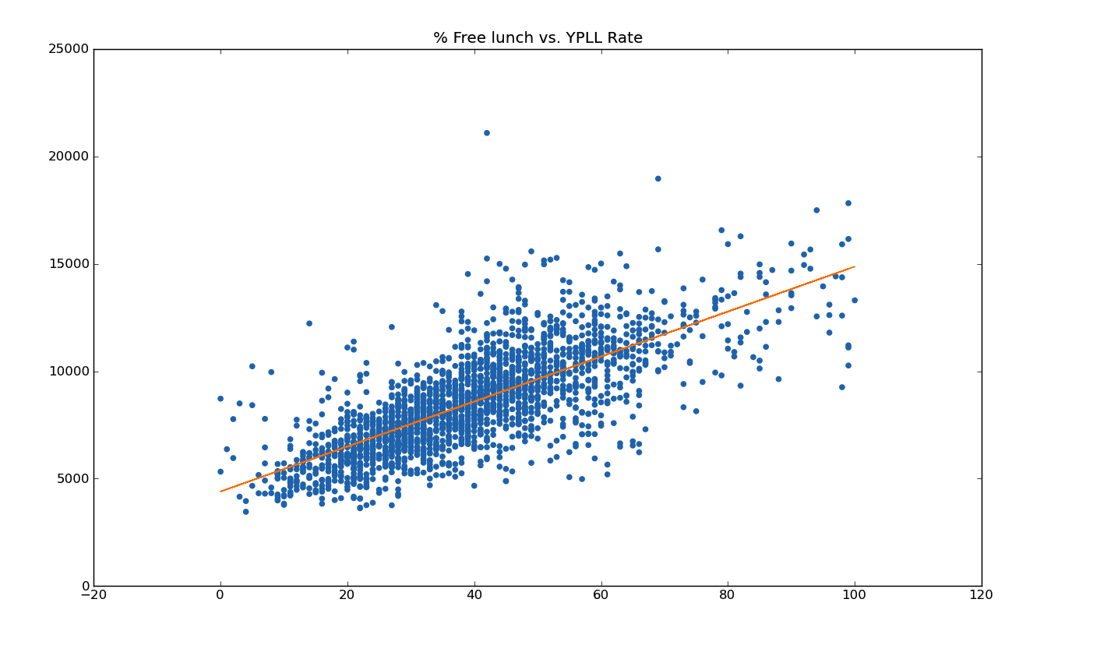
Terribleness of Life
% free lunch

Slide 31
summarizing distribution w/ numbers summarizing distribution w/ trends comparing distributions correlating distributions

Slide 32
visual analogs to statistics complex groupings

Slide 33
Visual analogs to statistics
t-test
regression/correlation
Notes:
And others! Conditioning vs. Brushing: http://bl.ocks.org/mbostock/4063663

Slide 34
Most viz you’ve seen so
far is oversimplified

Slide 35
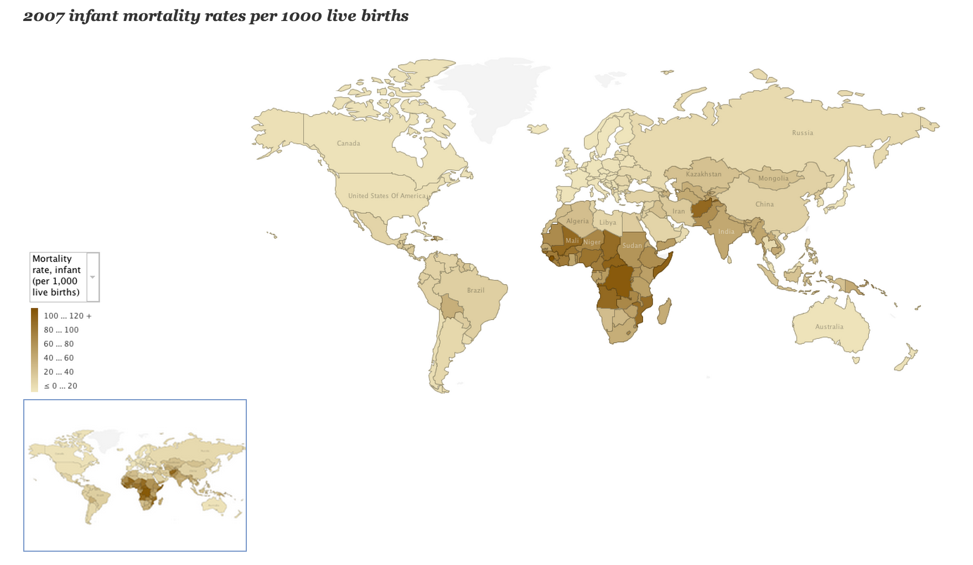
Notes:
http://blogs.ubc.ca/datavis/2012/04/02/horn-of-africa-data-visualizations-for-nytimes-article-kim-nursall-heather-roy/
Tension between complex quantitative analysis and complex groupings: here we focus on complex geographic groupings, but have a simple statistic per group.

Slide 36
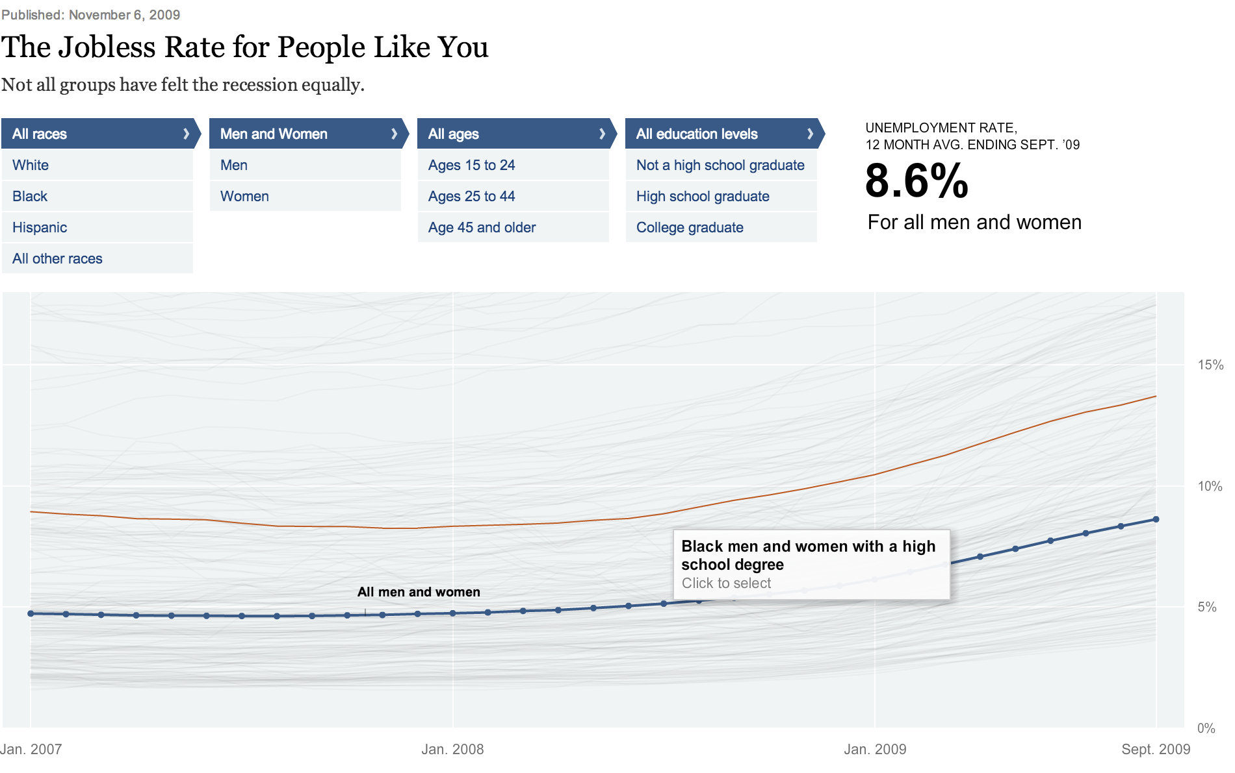
Notes:
http://www.nytimes.com/interactive/2009/11/06/business/economy/unemployment-lines.html?pagewanted=all
So many groups, so keep the visualization of each group small: a trend line

Slide 37
Graphical Principles
Notes:
Show you many graphics, some

Slide 38
Graphical Principles
Make the data stand out
Don’t obscure it
Elements of graphing data
Notes:
Show you many graphics, some

Slide 39
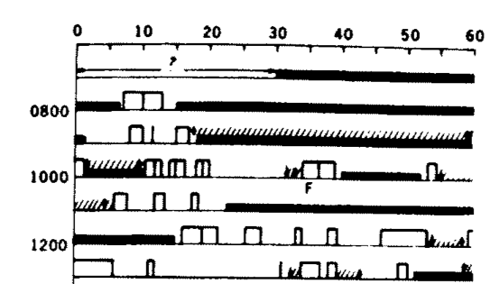
Elements of graphing data
Notes:
!Kung (african tribe from botswana and namibia). Long interval between births, interesting because no birth control nor abortions
Harvard anthropologists (Melvin Konner and Carol Worthman) suggests its because of very frequent nursing in first 1-2 years of life. Nursing secretes prolactin, which reduces gonad functions – natural birth control
Open bar = nursing
Closed = baby sleeping
F = fretting
/// = holding
Arrows for picking up/down

Slide 40
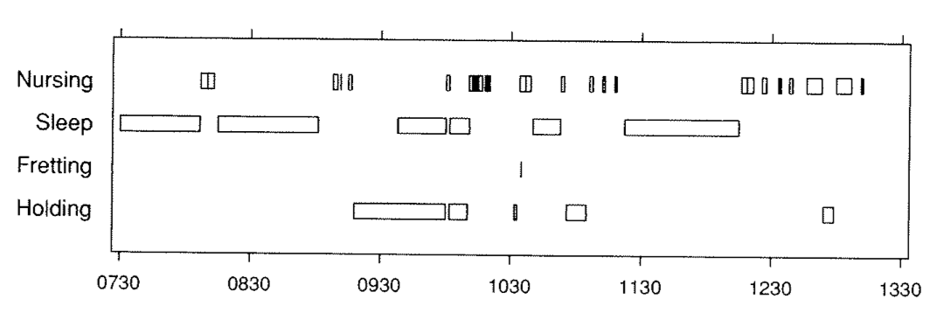
Elements of graphing data
Notes:
No need to constantly refer to a legend or chart
They share the same x axis so its clear what time it is
It’s easy to see the distribution of child state
Nursing and holding are infrequently done together
Can see overlap!

Slide 41
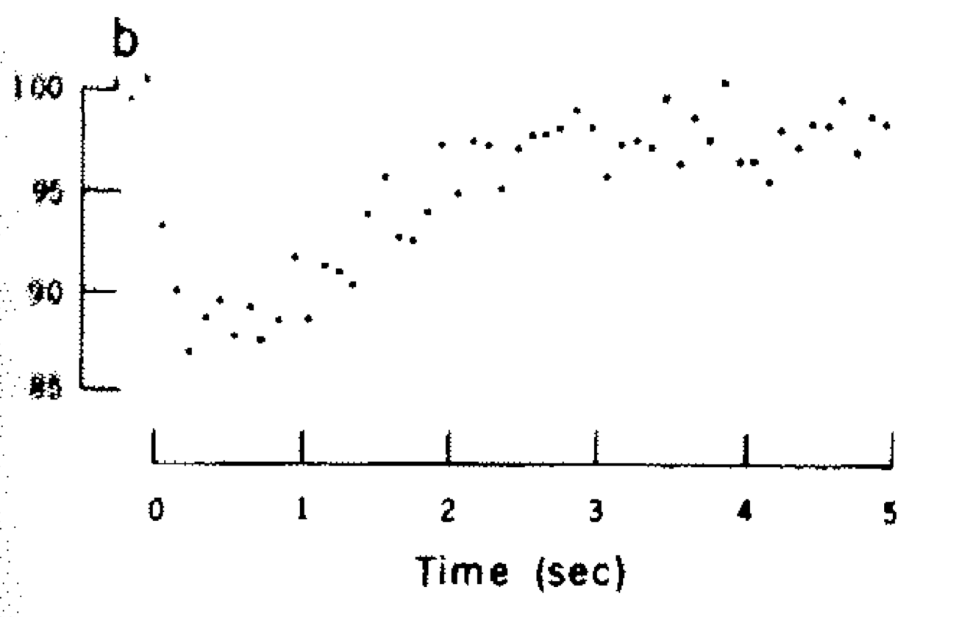
Elements of graphing data
Notes:
Quickly go through some other cases where The axes and other non-data components (legends, reference lines, adornments) can obscure the data

Slide 42
Elements of graphing data

Slide 43
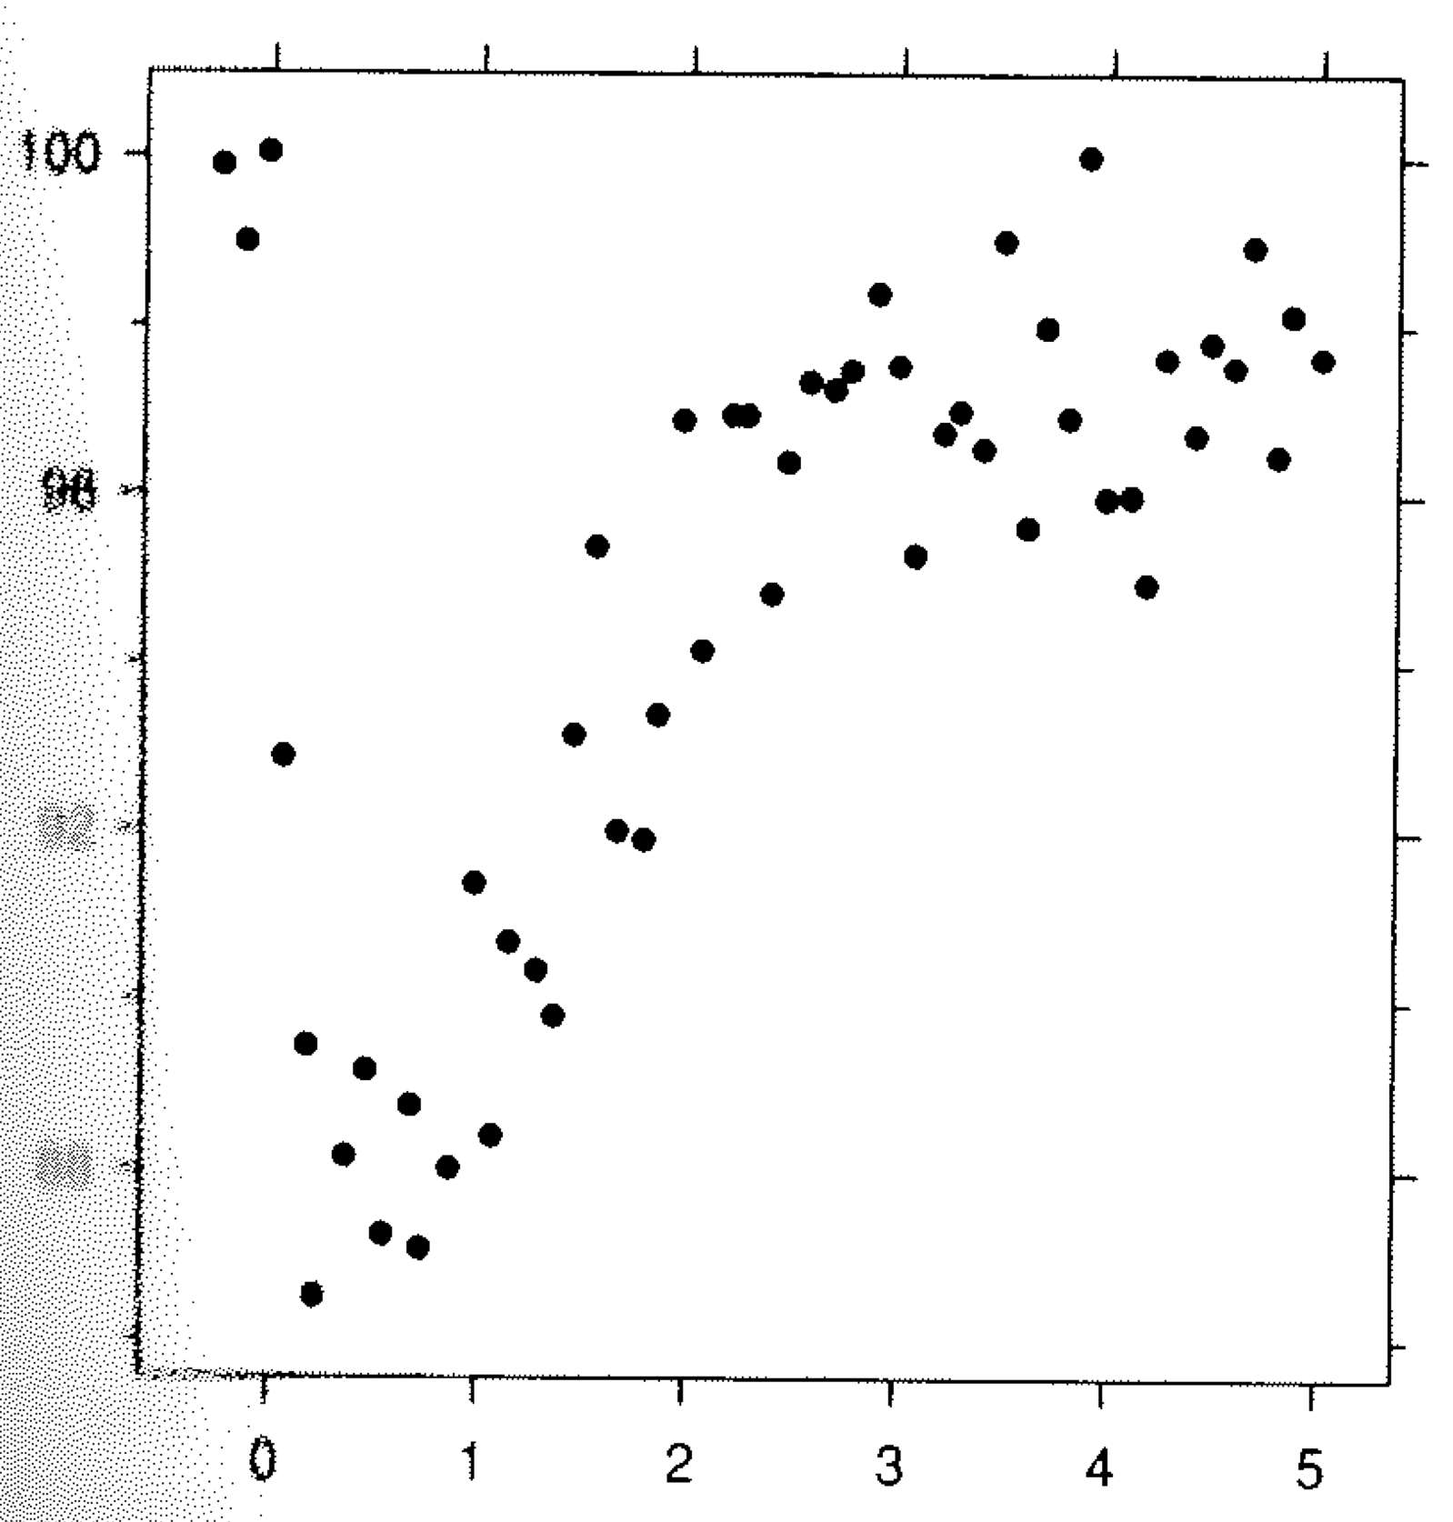
Elements of graphing data
Notes:
So the lesson is to clearly delineate and give padding for the data region

Slide 44
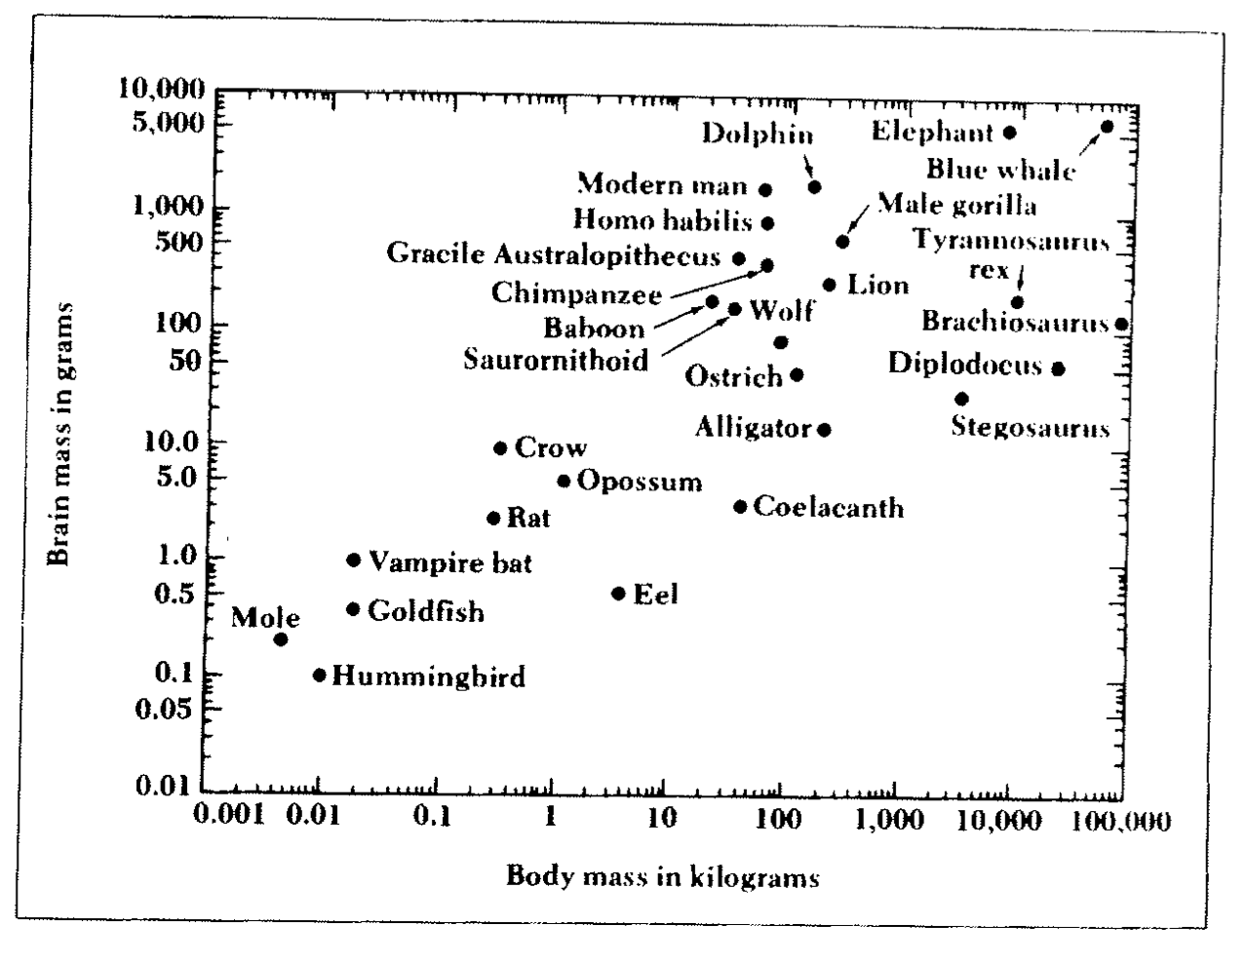
Elements of graphing data
Notes:
Different attributes of the data (in this case the labels) are obscuring the numerical data.
We are trying to show three dimensions – brain, body, and animal
Reducing the amount of info helps make it clear
But we can’t just remove the labels, because they’re important

Slide 45
Elements of graphing data

Slide 46
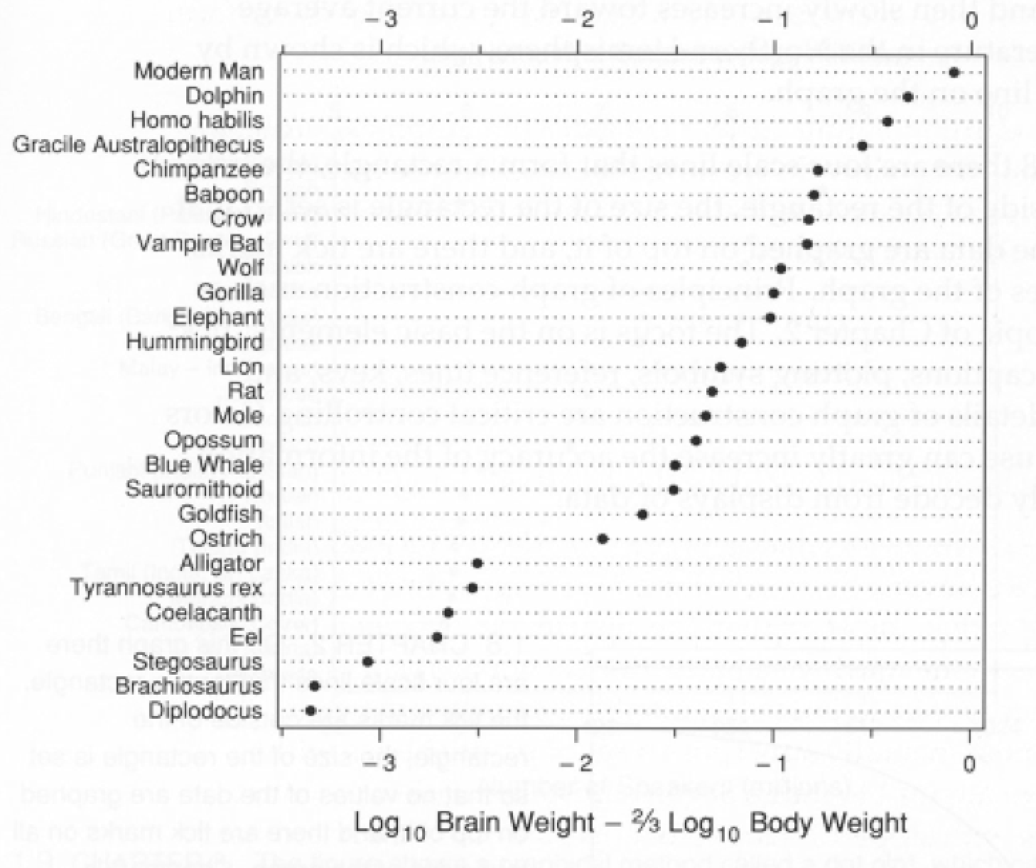
Elements of graphing data
Notes:
Instead, we reduce the dimensionality by combining brain and body weight

Slide 47
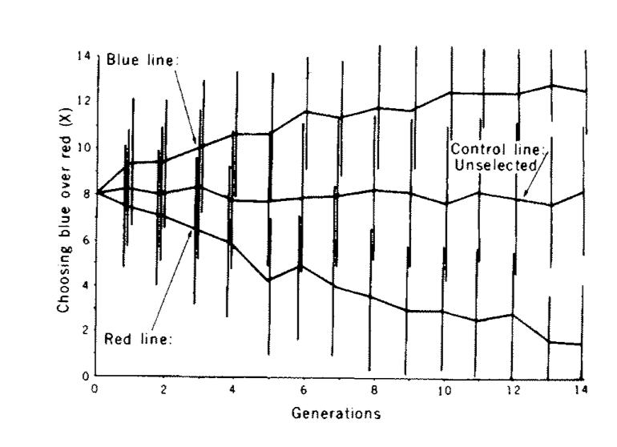
Elements of graphing data
Notes:
This an example where different messages can obscure each other.
In this graph we’re plotting red, blue and control lines for an experiment (presumably yeast cells – generations)
And since this is science we should indicate the amount of uncertainty, which are the vertical bars
What can we do?

Slide 48
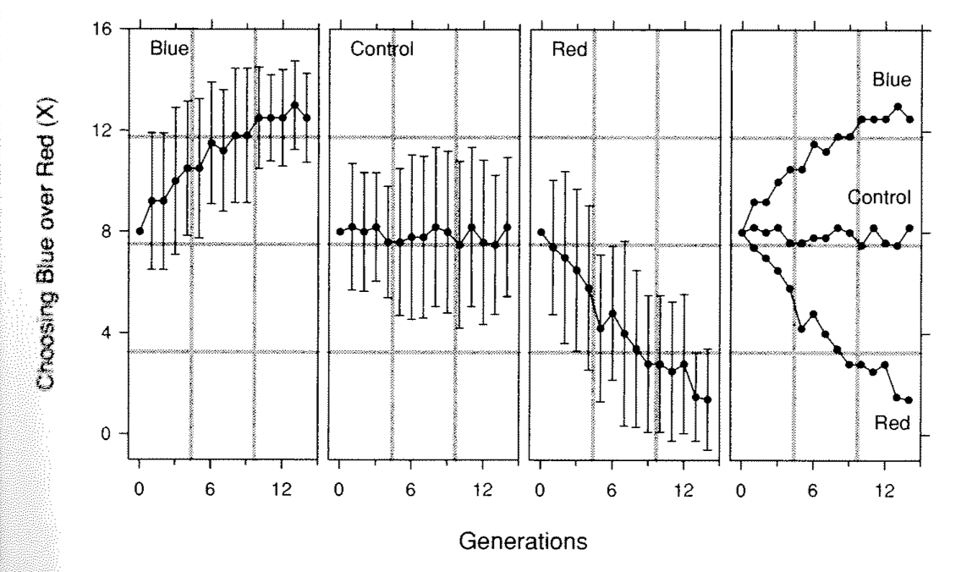
Uncertainty
Comparative

Slide 49
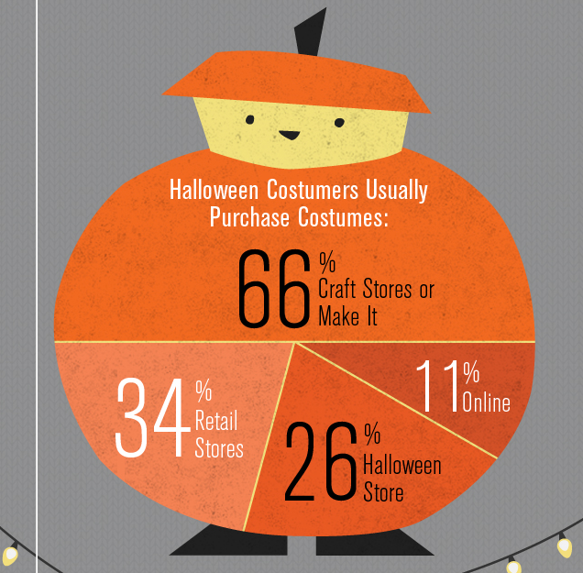
http://wtfviz.net/
Notes:
Finally this is the cutest graphic ever … that’s also the wrongest graphic ever
However cuteness may have superceded not just the presentation of data, but also its accuracy

Slide 50
“Use definite, specific, concrete language”
“Do not overwrite”
-Elements of Style
Notes:
These principles are analagous to those for writing, both forms of communication. Strunk and White Says…
Classic writing style guide

Slide 51
“Use definite, specific, concrete language”
“Do not overwrite”
-Elements of Style
1 message/graphic
Data >> Cuteness

Slide 52
Graphical Principles
Make the data stand out
Don’t obscure it
Is the data accurately perceived?
data → perceptual mapping
Notes:
Marketing obscures
Marks and graphical labels obscure
Spacing obscures
Multiple messages obscure
Show you many graphics, describe the goal and discuss how the data is being obscured

Slide 53
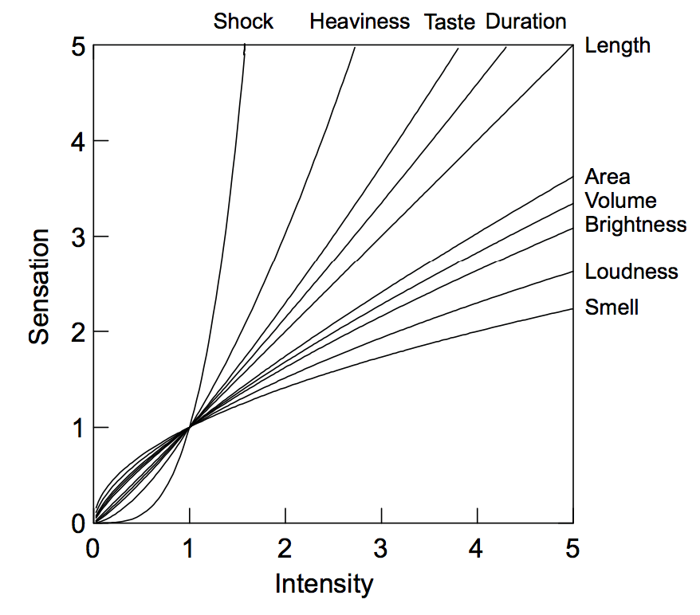
S = kI^{p}
Notes:
You can map numerical values to _anything_, for example, you could imagine transmitting data by twisting someones ear, and twisting it harder for higher values
it turns out that humans perception is highly non-linear in many cases.
It started in the 1860s and came back around 1950s
X axis is the value, Y axis is the perceived value or sensation
power-law psychophysical curves for a variety of stimuli using data from Shiffman (1990), Stevens (1961), and other sources.
Note that electric shock has an exponent greater than 3. For this and other reasons, shock would not be a good aesthetic candidate for repre- senting a dimension in a statistical graphic.

Slide 54
Position
Better
Length
Length
Angle
Area
Volume
Color
Worse
Text
2
4
Notes:
In terms of numerical values – not categorical data
This is a rough approximation of good vs bad visual encodings
Length suggests that scatter >> bars

Slide 55
Visualization Toolkit Models
Component
Grammar
D3.js
HTML/DOM
Notes:
Two main models when using visualization toolkits – for this case on the web
A very flexible library called d3
Which all sits on top of your browser

Slide 56
Visualization Toolkit Models
name | lat | lon | time | #
TD Garden | 42.2 | -71.1 | 1pm | 100
South Stn | 42.3 | -72.1 | 1pm | 200
TD Garden | 42.2 | -71.1 | 3pm | 100
Notes:
Regardless of what model we use, our goal is to construct a mapping between the records in our transformed dataset

Slide 57
Visualization Toolkit Models
name | lat | lon | time | #
TD Garden | 42.2 | -71.1 | 1pm | 100
South Stn | 42.3 | -72.1 | 1pm | 200
TD Garden | 42.2 | -71.1 | 3pm | 100
Notes:
And a set of visual elements

Slide 58
Visualization Toolkit Models
Component
Grammar
D3.js
HTML/DOM
Notes:
Two main models when using visualization toolkits – for this case on the web
A very flexible library called d3
Which all sits on top of your browser

Slide 59
Component model
Bar Chart
Line Chart
Munged
Data
Renderer
Stacked Line Chart
Pie Chart

Slide 60
Component model
Bar Chart
Learn attr domains
Map data → bar attributes
Render bars, axes, legend
Interaction
Munged
Data
Renderer
Notes:
What’s great about the component model?
Really easy to use (if it does what you want)
What some issues with the component model?
Stuck with their implementation
Only emcompasses the rendering portion of the pipeline
Structured data transformations, scaling, changing data types, layouts, are all difficult to achieve
Black box

Slide 61
Component model
Bar Chart
Learn attr domains
Map data → bar attributes
Render bars, axes, legend
Interaction
Munged
Data
Renderer
Notes:
What’s great about the component model?
Really easy to use (if it does what you want)
What some issues with the component model?
Stuck with their implementation
Only emcompasses the rendering portion of the pipeline
Structured data transformations, scaling, changing data types, layouts, are all difficult to achieve
Black box

Slide 62
Demo!
Notes:
Difficult to iterate
change variables to render
add aesthetic variables (color)
change ordering
change layout
change scaling e.g., log transform
change aesthetics (point, bar)
change data goruping
change variable types
Only performs rendering part of visual analysis

Slide 63
Visualization Toolkit Models
Component
Grammar
D3.js
HTML/DOM
Notes:
One of our arguments is that the graphic is defined by the intended
message/insight, and so entire visualization is driven by the
message. What would a language to represent this message look like?
It turns out that there is a structued approach towards creating
statistical graphics. It can be broken down into several orthogonal
components

Slide 64
What are the components of a graphic?

Slide 65
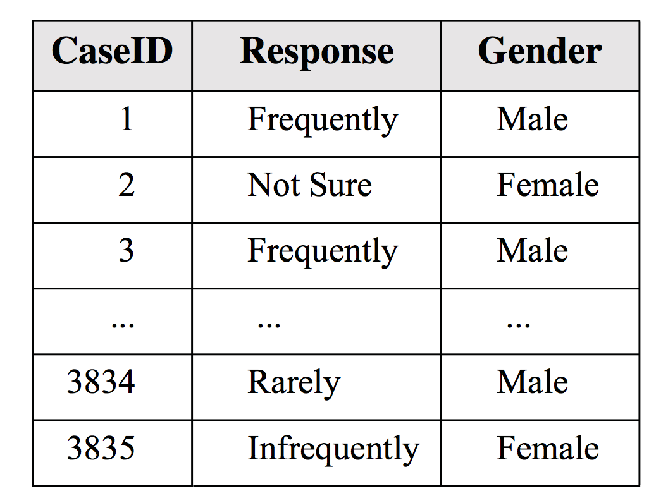
Data
Notes:
Each row records the gender of the respondent and their response.
A survey of U.S. scholars. Commissioned by the American Council of Learned Societies. Reported in Morton and Price (1989). Surveyed were 5,385. Respondents numbered 3,835. Response rate was 71 percent. Among respondents, 74 percent were male, 26 percent female. Respondents answered the question, “How often, if at all, do you think
the peer review refereeing system for scholarly journals in your field is biased in favor of males?”
We would like to show the disribution of response types by gender as a pie chart

Slide 66
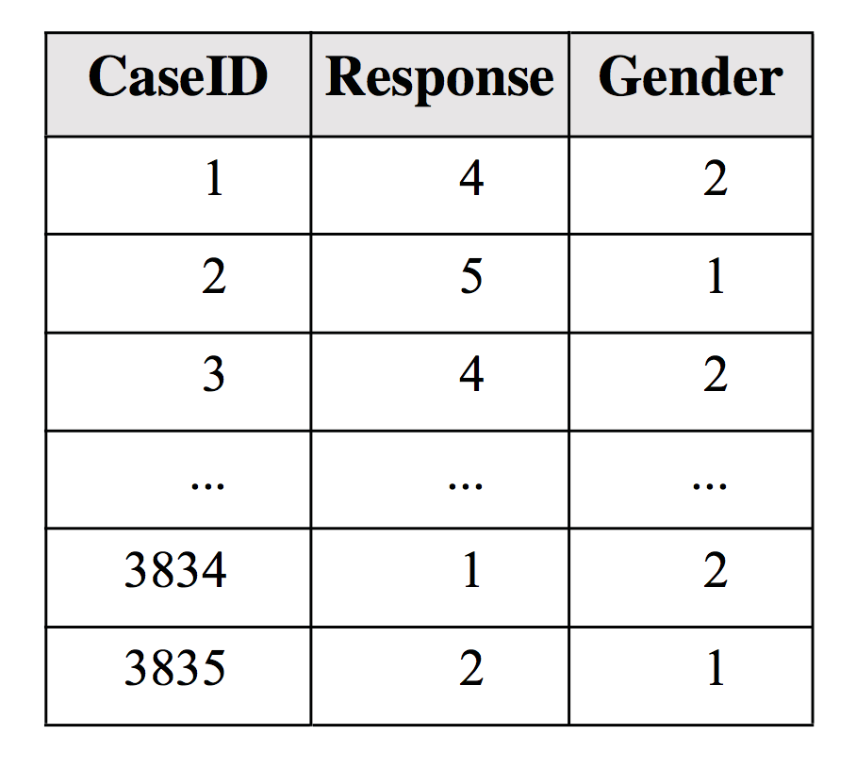
Data
Scales
Response: categorical
Gender: categorical
Notes:
The responses and gender are both categorical, and response has an ordering (rare to infrequently)
To force this ordering, we can transform the values into integers
Now let’s actually group the data by gender and compute the percentages of each response

Slide 67
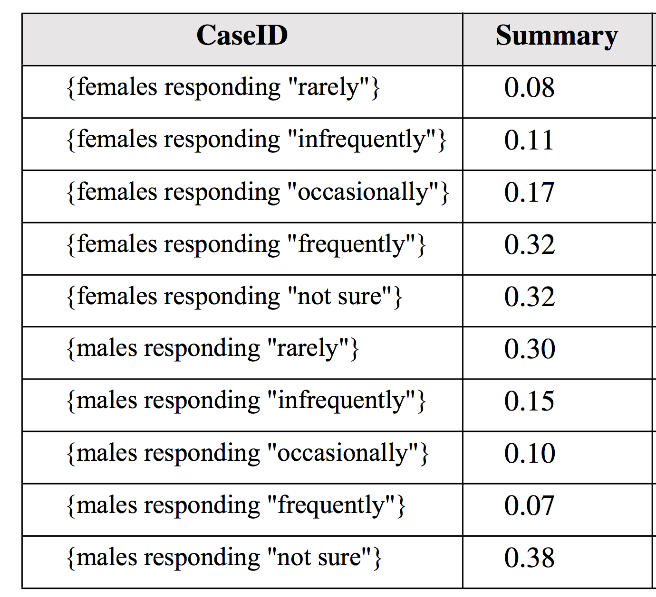
Data
Scales
Response: categorical
Gender: categorical
Statistical Transform
Bin
Notes:
The next step is to map the summary to transform this numerical statistic into the pixel domain

Slide 68
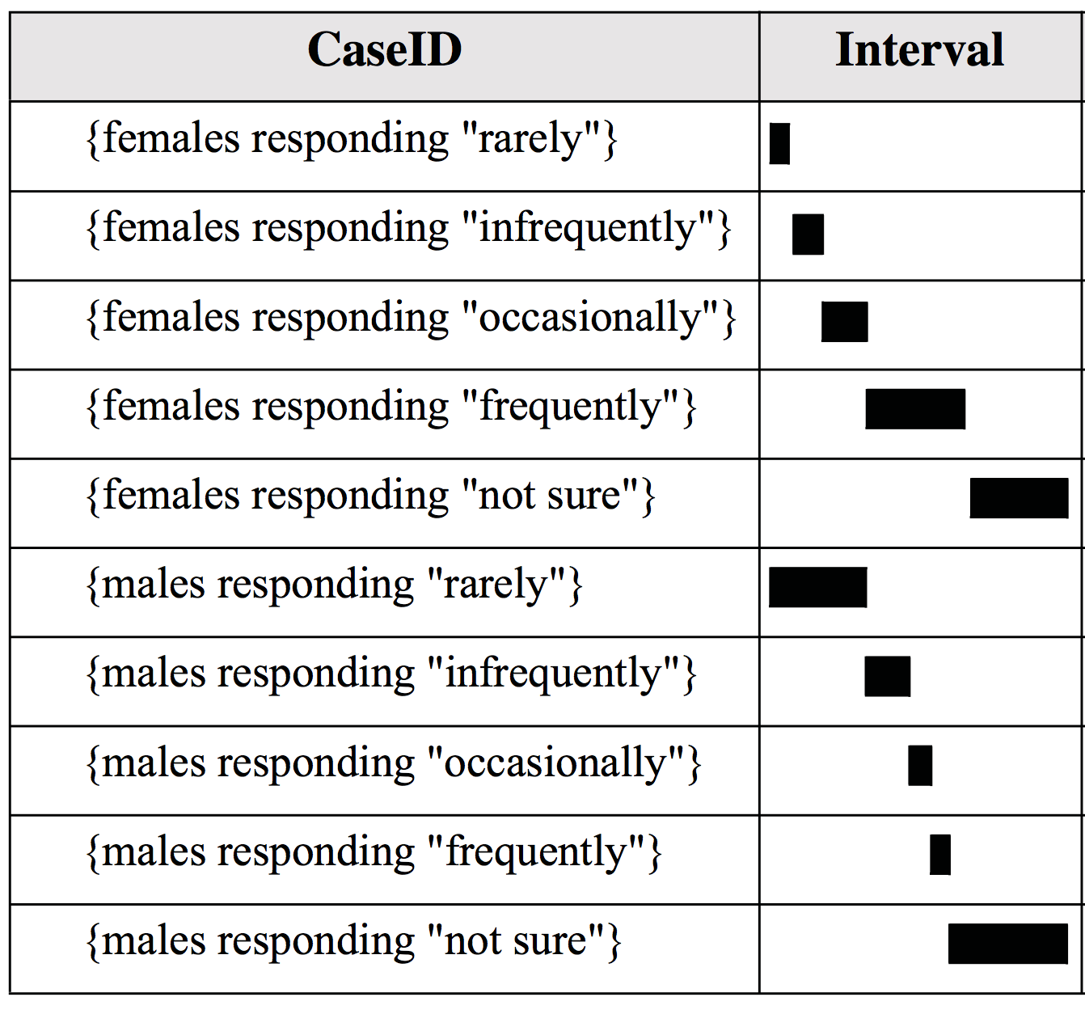
Data
Scales
Response: categorical
Gender: categorical
Statistical Transform
Bin
Geometry Mapping
Data → Interval
Notes:
Intervals are objects with a start and end. The end is set at the summary value and the start if not given is fixed at 0
If we render things as they are, the bars will all overlap

Slide 69
Data
Scales
Response: categorical
Gender: categorical
Statistical Transform
Bin
Geometry Mapping
Data → Interval
Positioning
Stacked
Notes:
So let’s stack the bars in each gender group on top of each other.
Notice this where the ordering does matter.

Slide 70
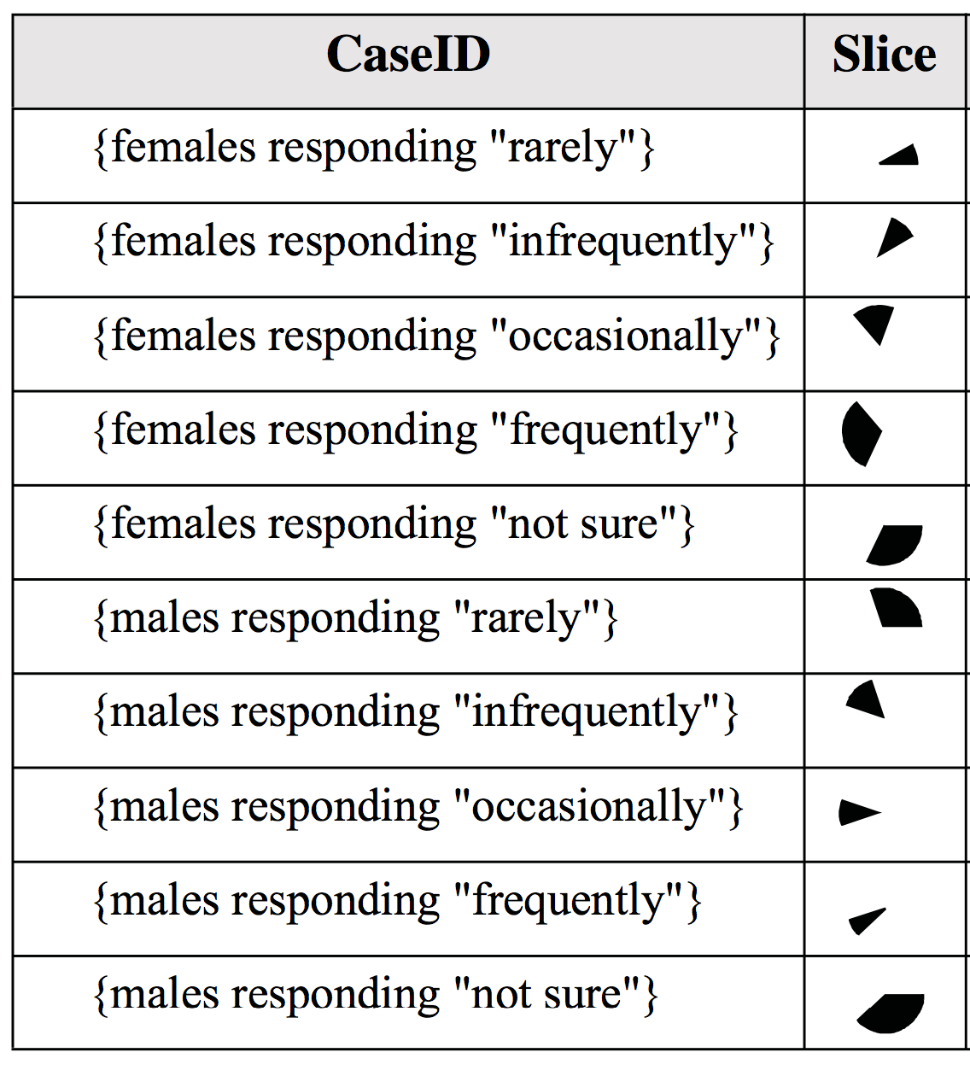
Data
Scales
Response: categorical
Gender: categorical
Statistical Transform
Bin
Geometry Mapping
Data → Interval
Positioning
Stacked
Coordinates
Euclidian → Polar

Slide 71
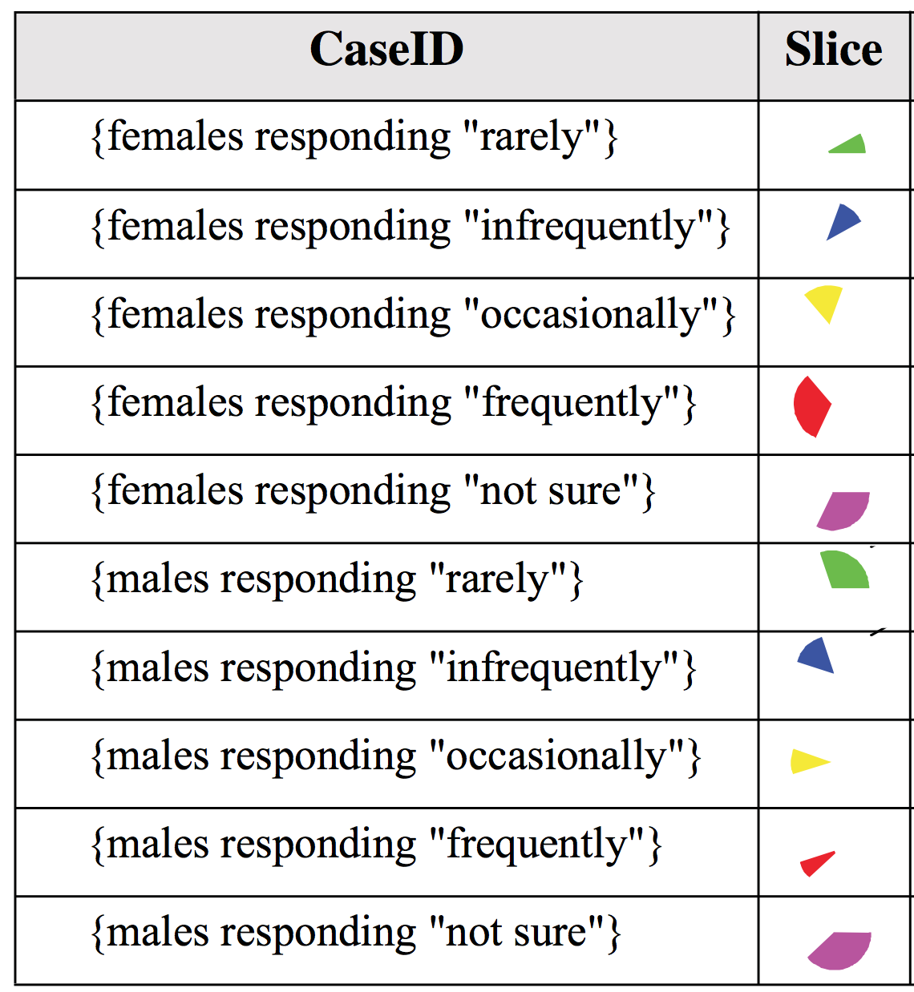
Data
Scales
Response: categorical
Gender: categorical
Statistical Transform
Bin
Geometry Mapping
Data → Interval
Positioning
Stacked
Coordinates
Euclidian → Polar
Aesthetic Mappings
Color: Response

Slide 72
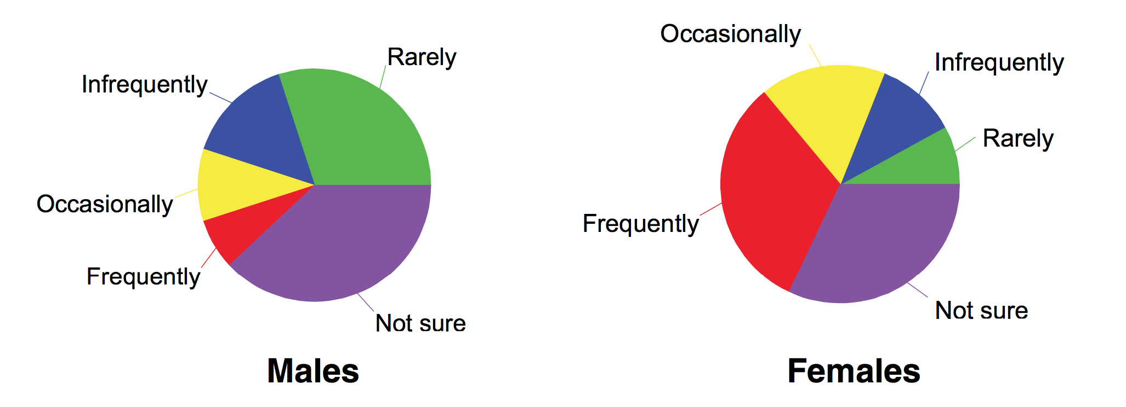
Data
Scales
Response: categorical
Gender: categorical
Statistical Transform
Bin
Geometry Mapping
Data → Interval
Positioning
Stacked
Coordinates
Euclidian → Polar
Aesthetic Mappings
Color: Response
Render

Slide 73
gg/ demo

Slide 74
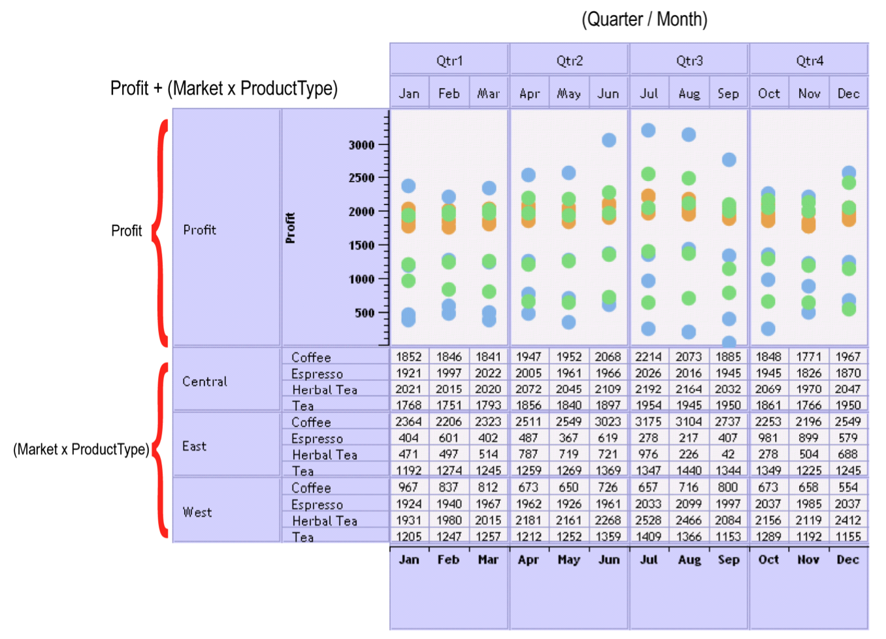
Tableau/Polaris
Notes:
Polaris takes the grammar idea and makes it useful for mere mortals in a constrained scenario: OLAP cube
Problem with grammars are they’re very difficult to learn and use, there is value in constraining the types of sentences to avoid syntactical errors.
Model: plot as a table of graphical cells
In the original paper, their main focus is on an algebra for defining the layout.

Slide 75
Component
Grammar
D3.js
HTML/DOM
Notes:
Walled garden

Slide 76
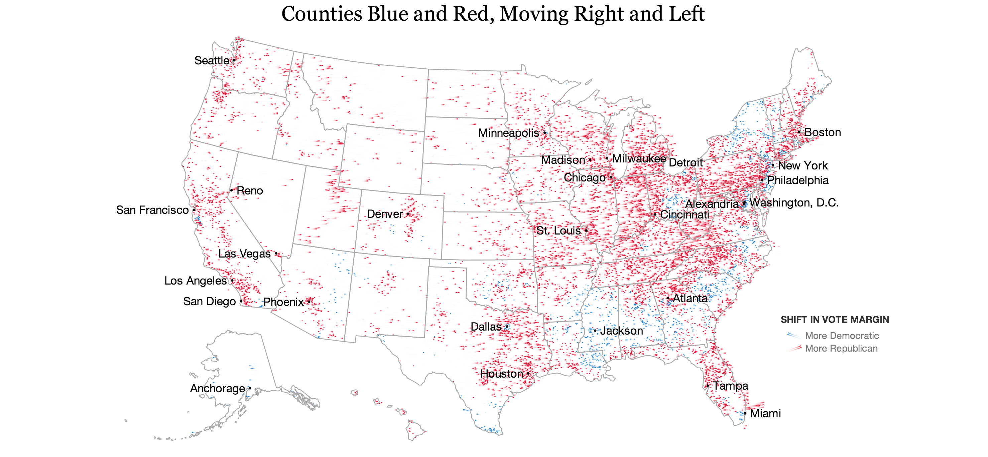
http://www.nytimes.com/interactive/2012/11/11/sunday-review/counties-moving.html

Slide 77
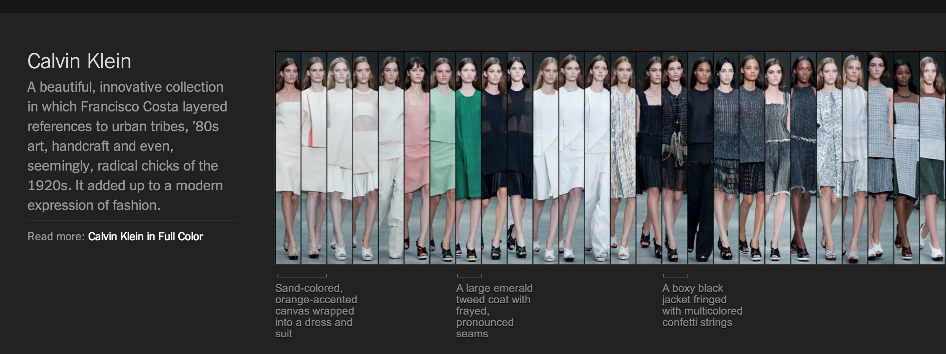
http://www.nytimes.com/newsgraphics/2013/09/13/fashion-week-editors-picks/

Slide 78
Data ⨝ DOM el
Notes:
D3 eschews the components and grammers and provides the lowest common denominator for building visualizations. Its core provides a single abstraction
Explain how left outer joins work
Data manipulation happens outside of d3
Layout: cluster, force, hierarchy, histogram, treemap, map
Interaction: brush, zoom
Show demo, then talk about how its implemented

Slide 79
demo

Slide 80
Data ⨝ DOM el
Array Utilities
Formatting
Shapes
Layout
Data Utilities
Color
Scales
Interaction
Notes:
Explain how outer joins work
Data manipulation happens outside of d3
Layout: cluster, force, hierarchy, histogram, treemap, map
Interaction: brush, zoom
Show demo, then talk about how its implemented

Slide 81
Conclude
Graphics are visual statistics
Graphic choice is driven by message
Don’t get in the way of the message
Three models of visualization toolkits

Slide 82
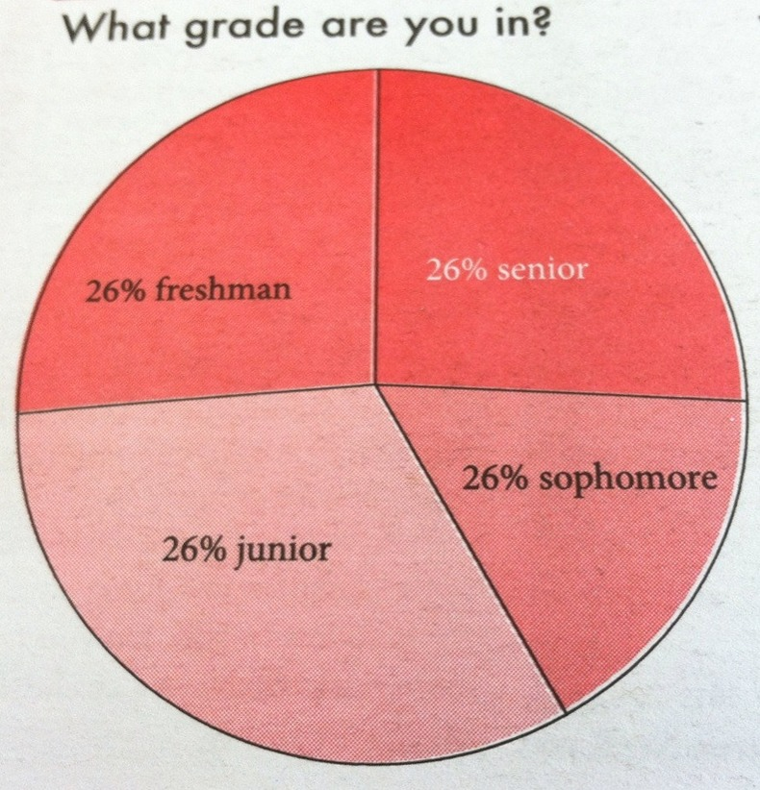
This is a non-effective graphic

Slide 83
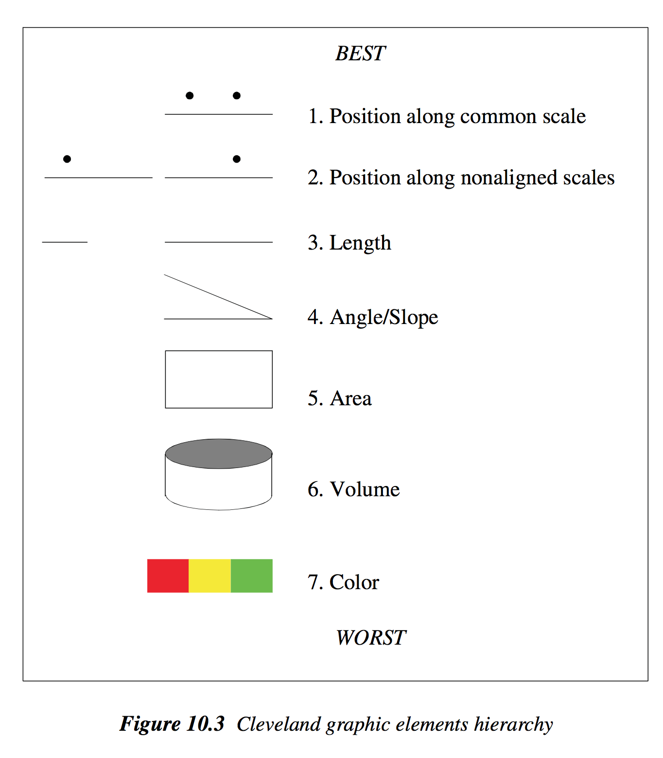

Slide 84
Exporting our mental processing
Comparing
Sorting/grouping
Scaling/normalizing
Cleaning
Summarizing statistics
Model fitting

Slide 85
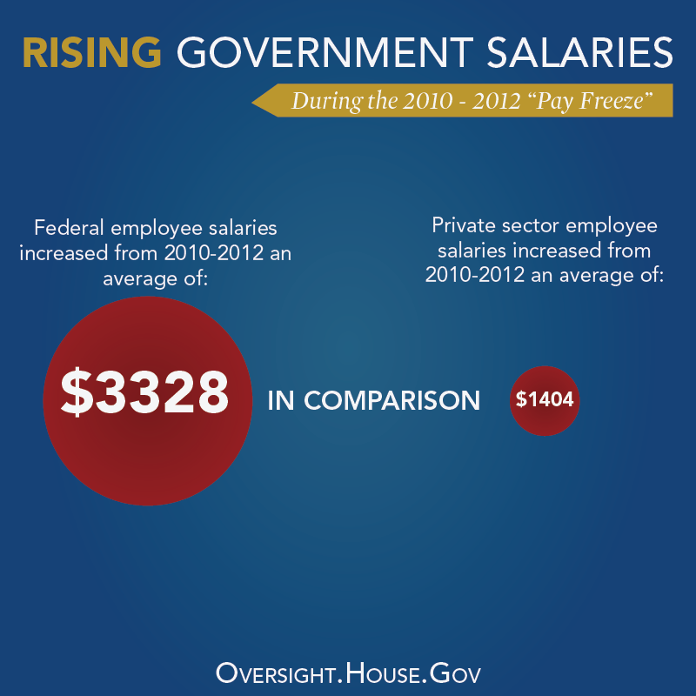
Notes:
2.37037

Slide 86
Notes:
2.37037

Slide 87
Notes:
2.37037

Slide 88
Until 1900, hand-drawn visualizations were the method for “statistical” data analysis
Early 1900s focused on precision and quantification
Pain to draw graphs, ANOVA techniques more precise

